Slide 1

Antenna Selection and Design
What’s Important?
Joe Reisert W1JR
April 12, 2015

Slide 2
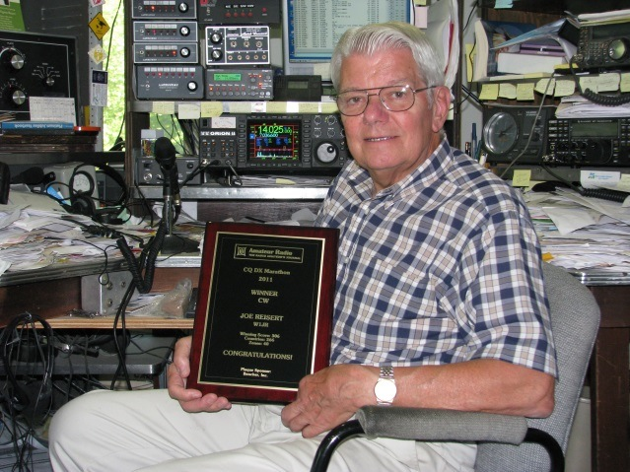
First licensed in 1951 as WN2HQL and has been a serious DXer since 1954. Formally W2HQL, WA6TGY, W6FZJ and W1JAA.
Top of the DXCC Honor Roll with 391/340 total, DXCC Challenge 3150. Satellite DXCC, and 11-band DXCC (160 through 6 meters including 60 Meters).
DXpeditions in 1957 as W2HQL/KC4 (Navassa I.) and as VP2VB in 1958 with Danny Weil.
Member of the YCCC Contest Club. Life member of ARRL and AMSAT. Over 135 published articles. DX Hall of Fame (2014).)
Joe Reisert, W1JR
W1JR April 2015

Slide 3
Antennas and Transmission Lines
General antenna characteristics
Antennas are the best investment in your station
Efficient antennas are likely to be narrow-band
Reliability can be as important as performance
Requirements related to effective designs
Pattern matching propagation path to DX
Impedance matching techniques
Baluns and chokes
Transmission line losses
Receiving antennas
Lightning and static protection
W1JR April 2015

Slide 4
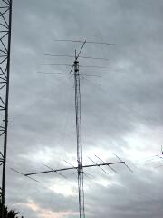
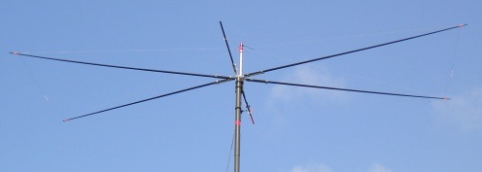
Monoband Antennas
Dipoles/Loops
Verticals
Full size: Yagi¹
Shortened: Moxon²
1
2
W1JR April 2015

Slide 5
Dipole and Loop Antennas (Feed point )
Half-wave
Dipole
G5RV
Wideband
Dipole
Inverted Vee
Folded
Dipole
1/3
2/3
Windom
Wideband
Quad
Delta Loop
Diamond Quad
W1JR April 2015

Slide 6
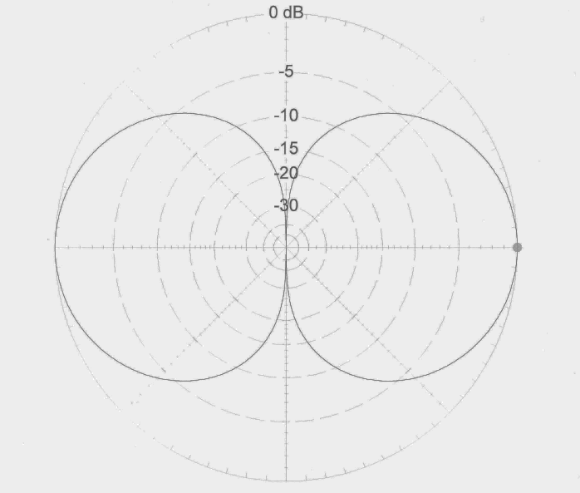
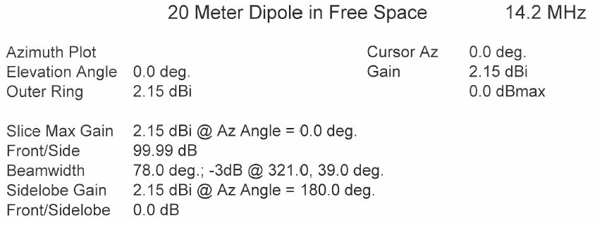
Antennas - HF
20M Dipole Free Space Pattern
W1JR April 2015

Slide 7
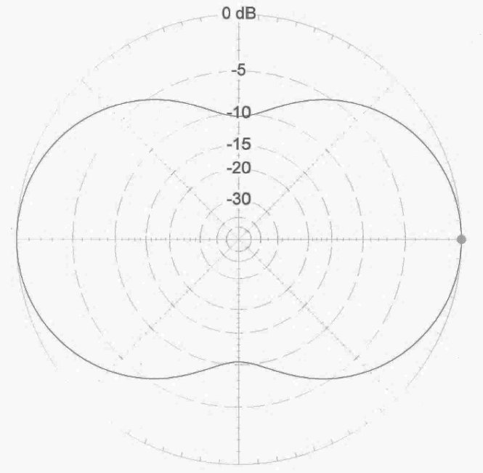
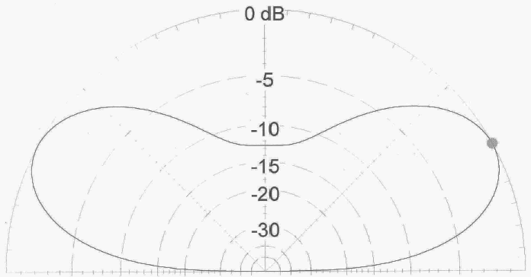

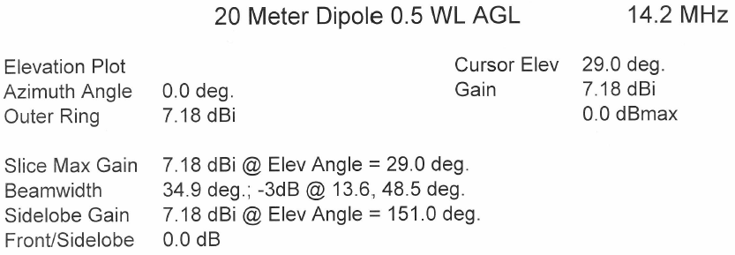
Antennas - HF
20M Dipole, Ht 0.5 Wave (Azimuth/Elevation Plot)
W1JR April 2015

Slide 8
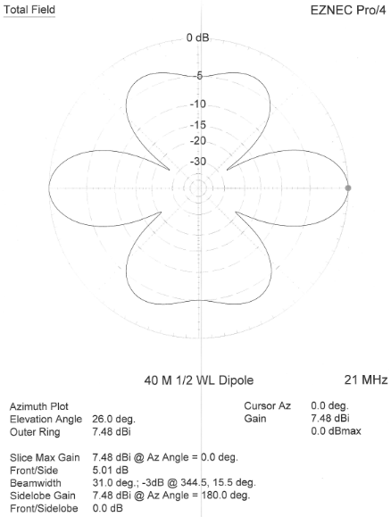
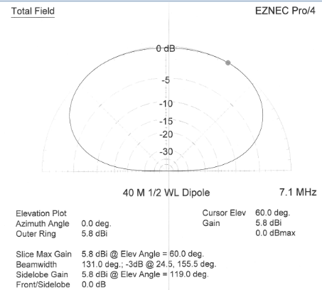
40m Dipole on 7.1 MHz, Ht 0.125 Wave
Same 40m Dipole on 21 MHz
W1JR April 2015

Slide 9
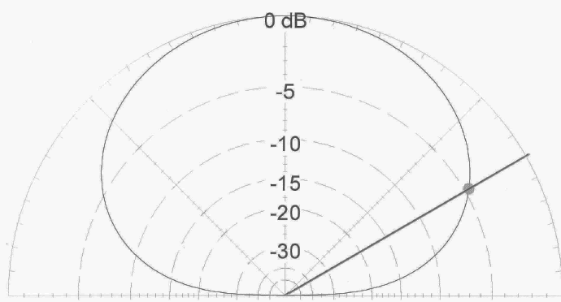
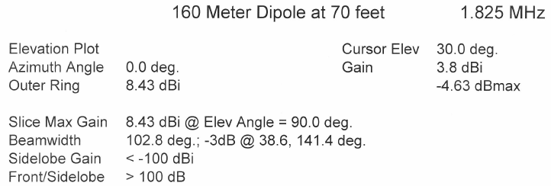
160M Dipole, Ht equals 70 Feet
W1JR April 2015

Slide 10
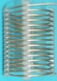
Typical Vertical Antennas including feed location
W1JR April 2015

Slide 11
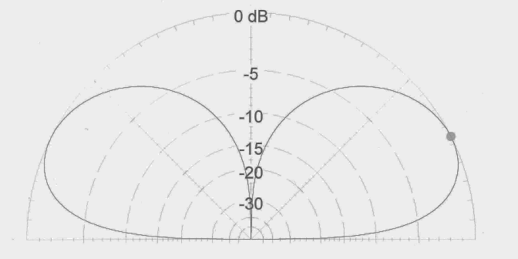
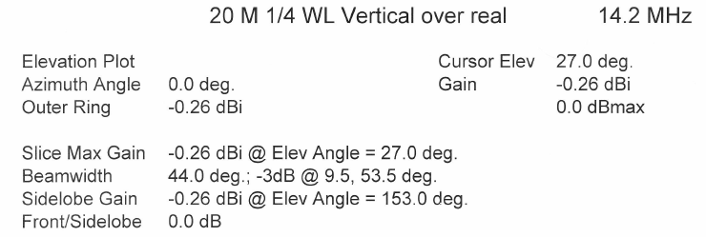
Antennas - HF
20M 0.25 Wave Vertical over real ground
W1JR April 2015

Slide 12
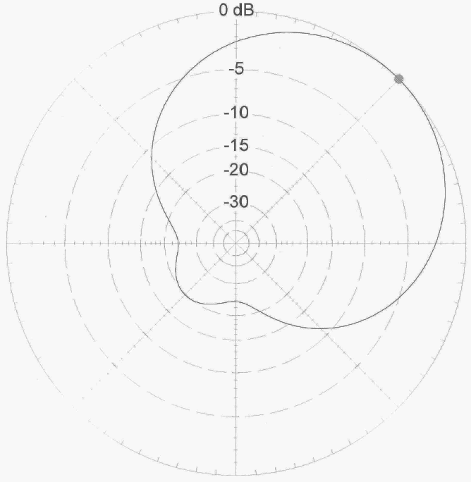
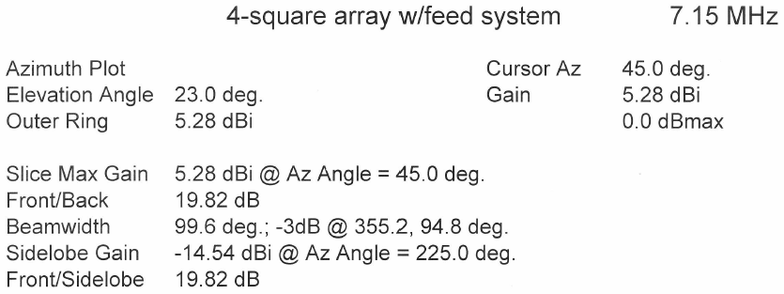
Antennas – Low Frequency (160, 80 & 40)
4-Square 40M Array with Feed System
W1JR April 2015

Slide 13
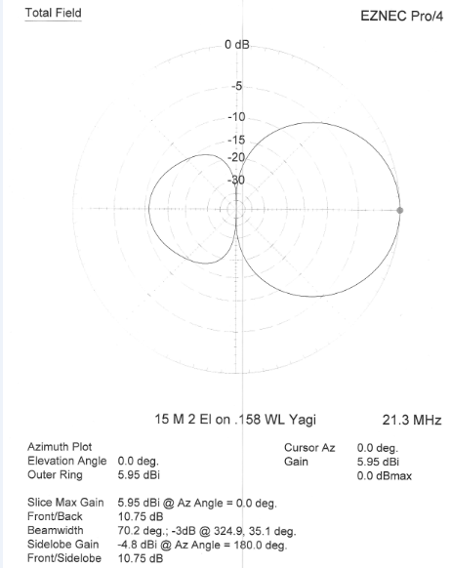
15m 2 Element 0.158 Wavelength Yagi
W1JR April 2015

Slide 14
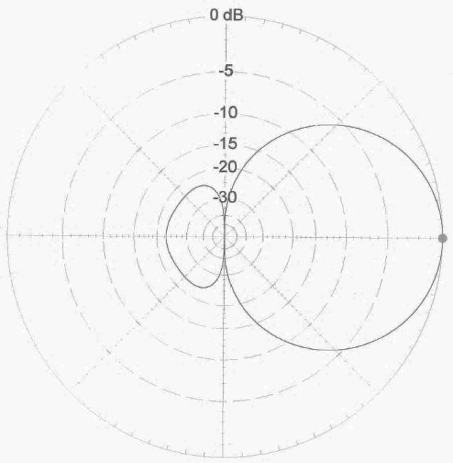
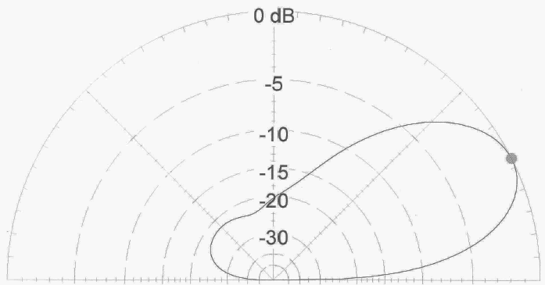
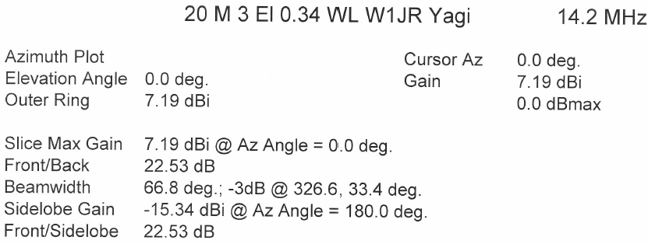
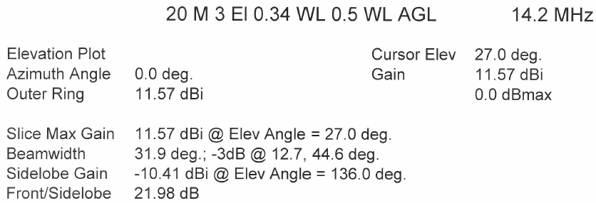
Antennas - HF
20m 3 Element Yagi, Ht 0.5 Wavelength Azimuth and Elevation Plot
W1JR April 2015

Slide 15
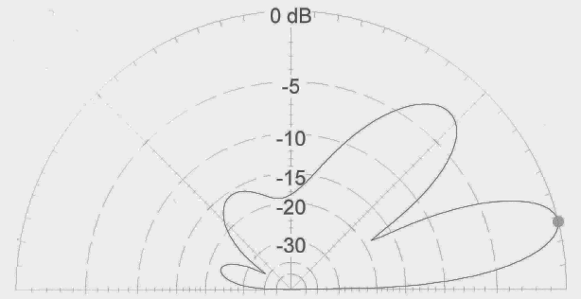
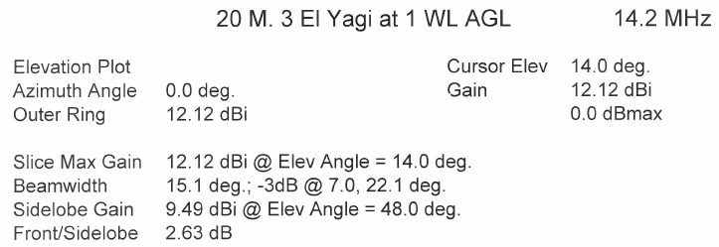
20m 3 Element Yagi, Ht 0.5 Wavelength
20m 3 Element Yagi, Ht 1.0 Wavelength
W1JR April 2015

Slide 16


20m 2 Element Quad
30m 2 Element Yagi
W1JR April 2015

Slide 17

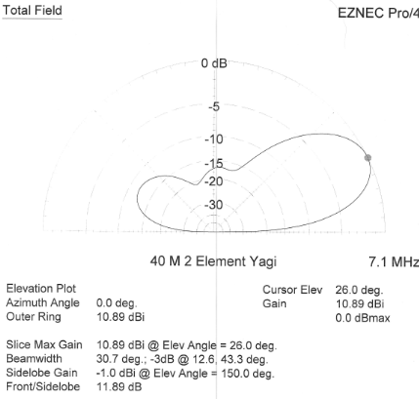
40m 2 Element Yagi, Ht 0.125 Wavelength
40m 2 Element Yagi, Ht 0.5 Wavelength
W1JR April 2015

Slide 18
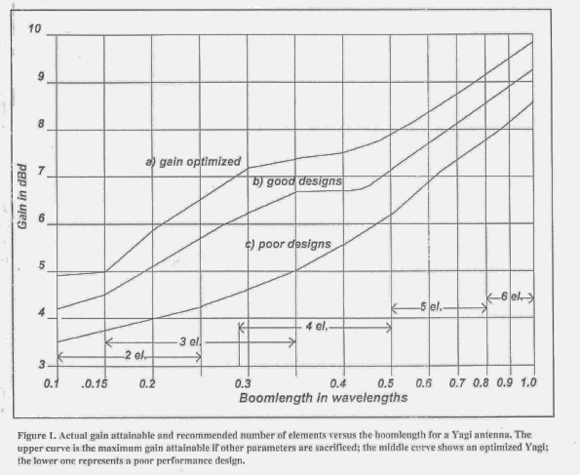
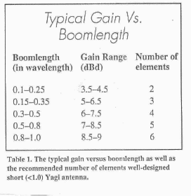
Antennas - HF
Typical Gain Vs. Boom Length
W1JR April 2015

Slide 19
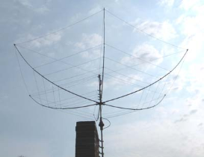
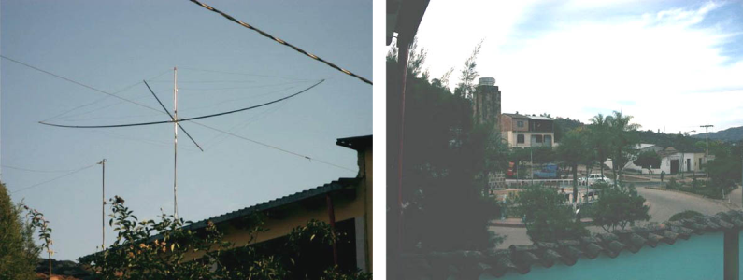
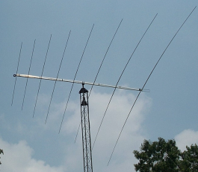
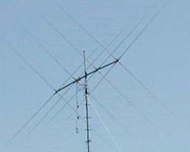
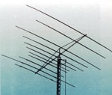
Typical Multi-Band Beam Antennas
Hexbeam¹
Spider beam²
Log periodic³
Quad⁴
Multiband Yagi⁵
Trap antenna
1
2
3
4
5
W1JR April 2015

Slide 20
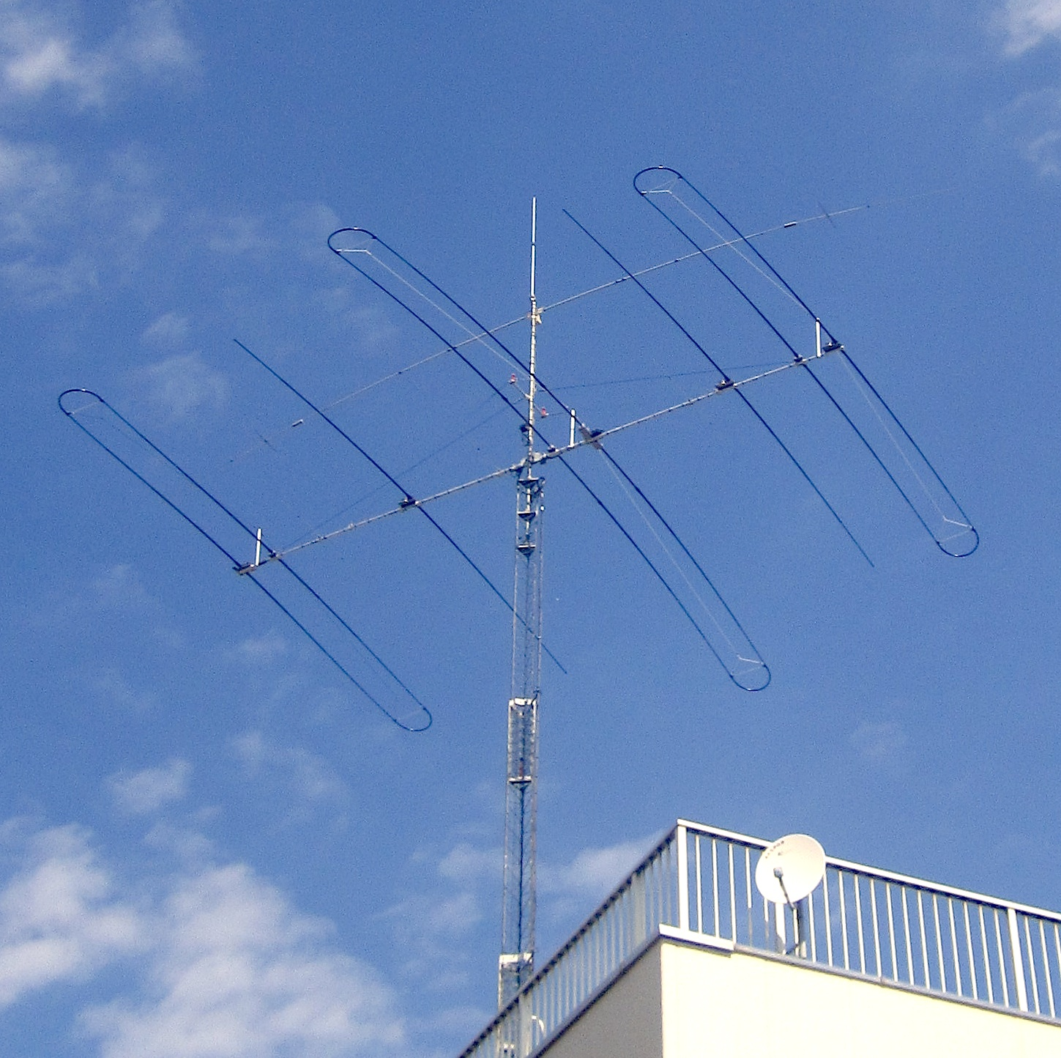
Adjustable Yagi
SteppIR
Many frequencies
Optimum performance
W1JR April 2015

Slide 21
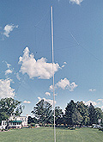
Typical LF Transmit Antennas
Dipoles/Loops (as high as possible)
Inverted “V” Dipoles
Verticals with many radials
Inverted “L”
Loaded Towers
W1JR April 2015

Slide 22
Typical Impedance Matching Networks
- Gamma Match
- Tee Match
- Beta Match
W1JR April 2015

Slide 23
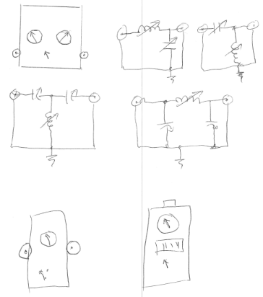
Impedance Matching, Antenna Tuners and VSWR Meters
(I’m not an artist!)
W1JR April 2015

Slide 24
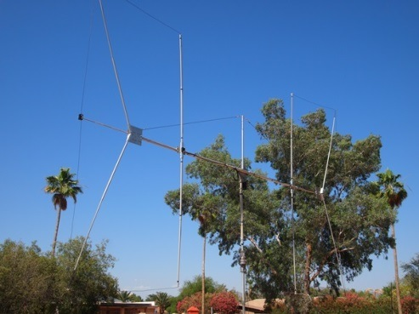
Typical Receive Antennas
Beverages
Loops (ground-dependent antennas)
Flag/pennants (ground-independent antennas)
3, 4 & 8 Element short vertical arrays
Front end protectors
W1JR April 2015

Slide 25
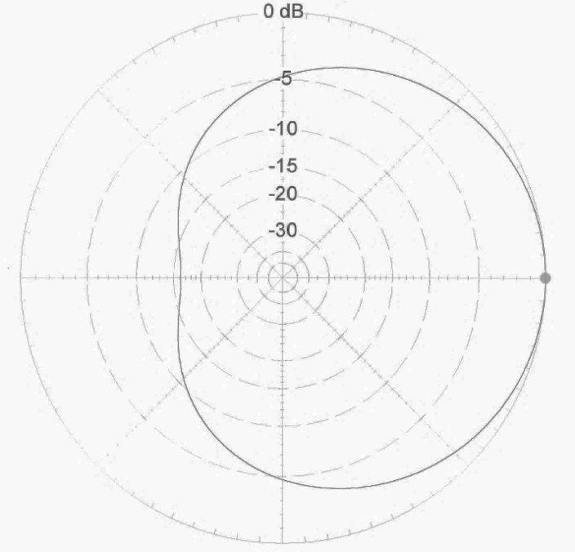
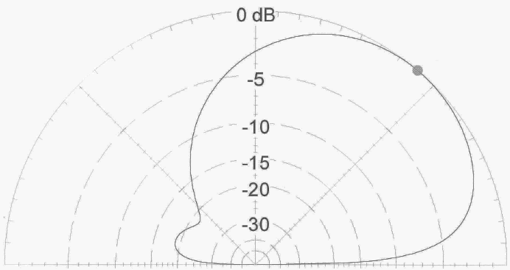
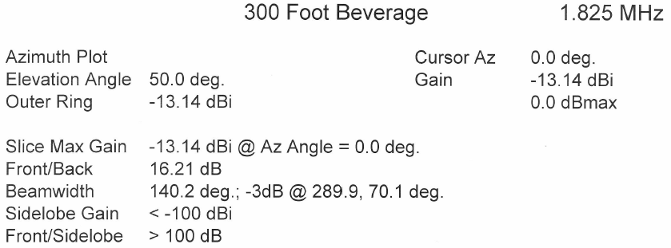
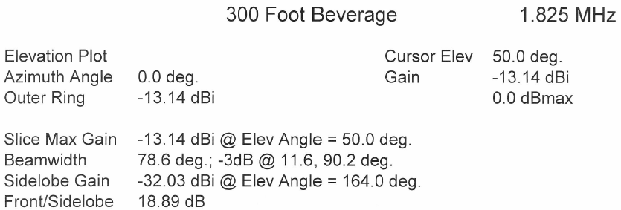
Azimuth and Elevation Plots of 300’ Beverage
W1JR April 2015

Slide 26
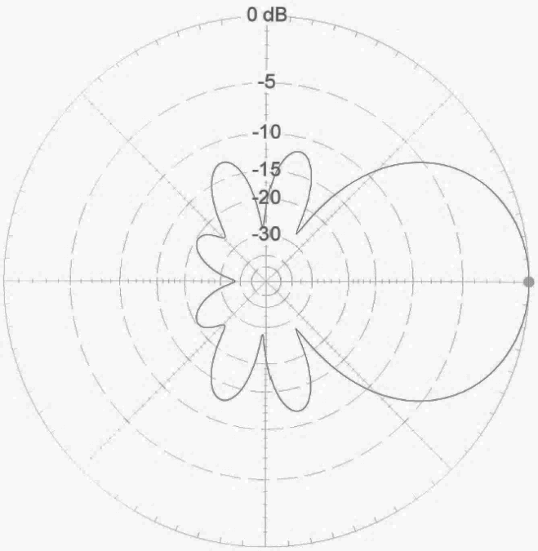
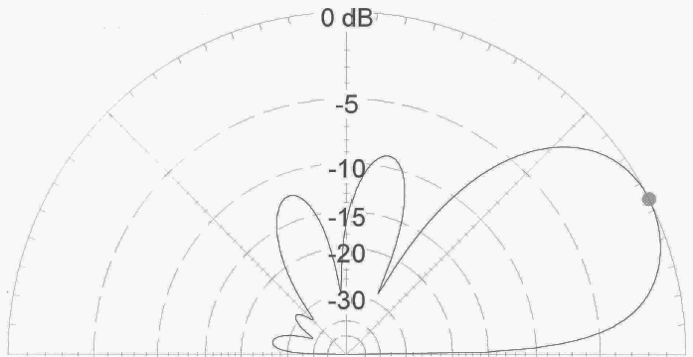
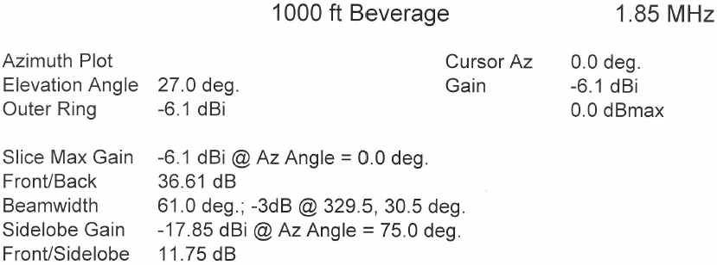
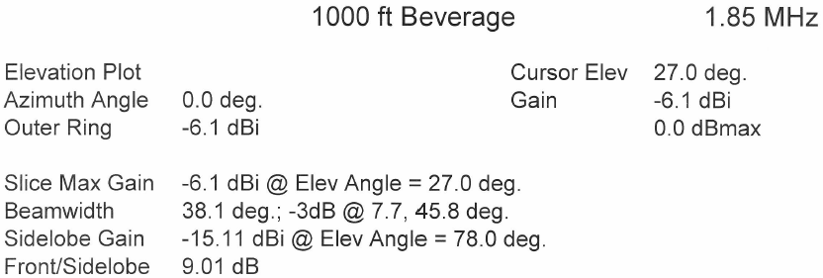
Azimuth and Elevation Plots of 1000’ Beverage
W1JR April 2015

Slide 27
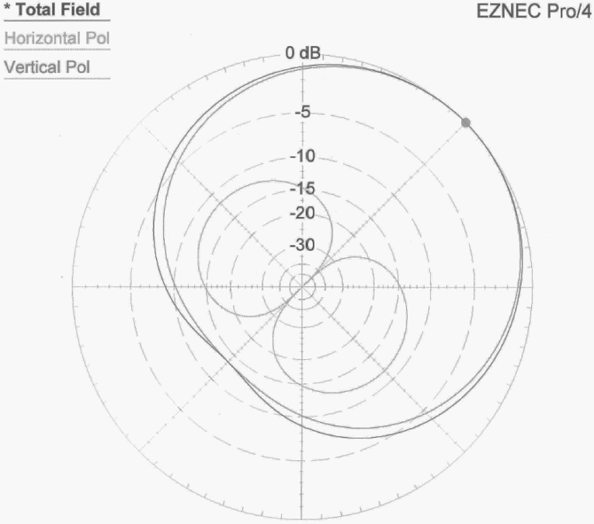
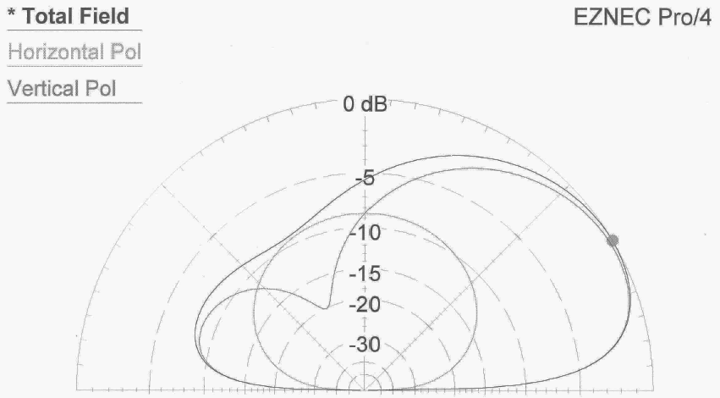
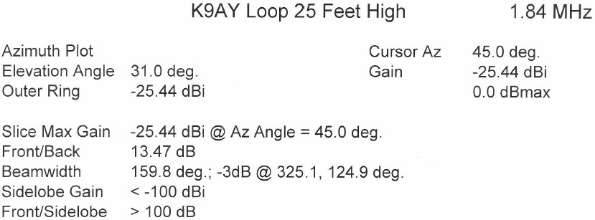
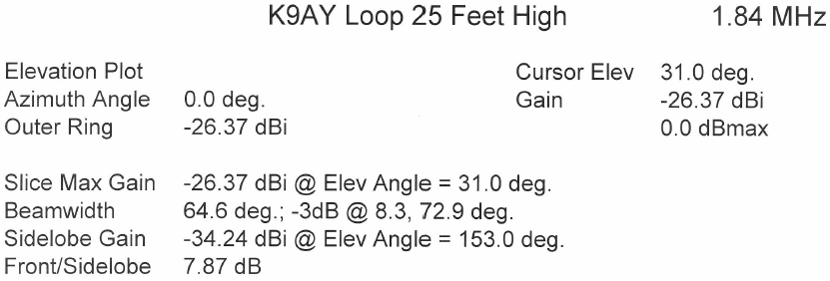
Azimuth and Elevation Plots of K9AY Loop
W1JR April 2015

Slide 28
Mechanical Considerations
1. Structural Evaluation of Yagi Element
2. Mechanical vibrations
3. Aerodynamic Balancing
4. Tower considerations
5. Insulators and guy lines
6. Animal and Human considerations
W1JR April 2015

Slide 29
Alternative designs.
-Modify an existing design
-Rebuild a junked antenna
-Good candidates for mods. are:
Cushcraft 40-2CD, XM-240, 50-5S
Hygain VB-66DX (6 meter 6 EL)
MFJ 1792 80/40 Vertical
W1JR April 2015

Slide 30
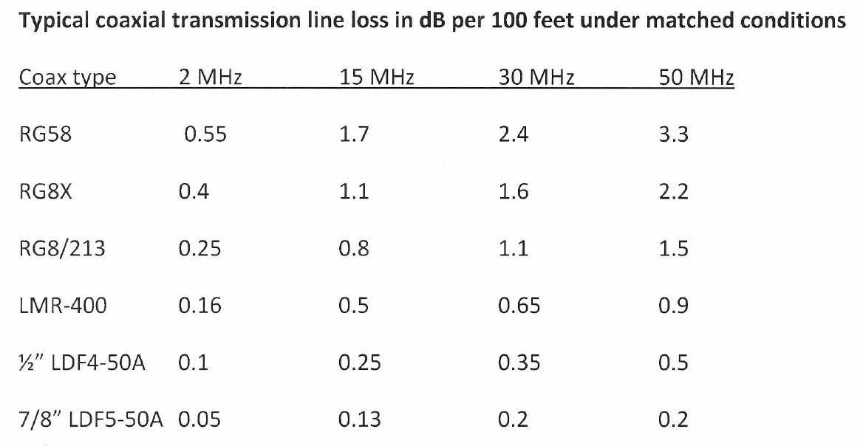
0.25
W1JR April 2015

Slide 31
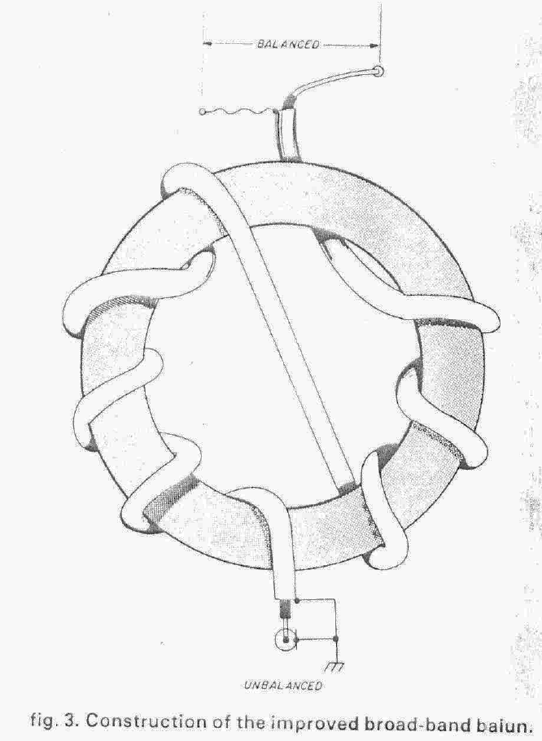
Construction of the improved broadband balun
Ferrite Bead Choke
W1JR April 2015

Slide 32

W1JR Balun/Choke 2.4” OD 12 Turns RG-303 on Type 61 Material Toroid
W1JR April 2015

Slide 33

W1JR Balun 2.4” OD Toroid, 12 Turns of RG303 on Type 43 Material
W1JR April 2015

Slide 34

W2DU Unadilla using 50 Ferrite Beads
W1JR April 2015

Slide 35

W1HIS Bead Choke 8x1” + 8x1/2” OD Type 31 Material
W1JR April 2015

Slide 36

Solenoid Choke 3.5” Diameter, 25 Turns RG-8X
W1JR April 2015

Slide 37

Grounding Considerations
Grounding towers and antennas
Nearby lightning strike protection
Shock hazard mitigation
Audio ground loop reduction
W1JR April 2015

Slide 38
Antenna Modeling
1. Harvard Thesis by I. Larry Morris
W2PV work with Morris thesis
NEC (Numerical Electrical Code
MININEC (Scaled down NEC)
YO, MN & AO by Brian Beezley, K6STI
EZNEC by Roy Lewellan, W7EL
W1JR April 2015

Slide 39
What have we learned?
1. Know your station and its capabilities.
2. The antenna is the most important part of you station.
3. Always use chokes or baluns.
4. Strive for 50 Ohm antennas.
5.You can never have enough antennas!
6. Keep transmission line losses to a minimum.
7. Protect your station from electrical discharge.
Happy Hunting
W1JR April 2015
Notes:
Summary

Slide 40
References
1. The ARRL Antenna Book, 22nd edition, Editor N0AX
2. Dean Straw, N6BV Propagation Charts and TLA program
3. Yagi/Uda Design, Part 1: A Different approach, Joe Reisert, W1JR, PP-49-59,
Communications Quarterly, Winter 1998
4. Low-Band DXing, 5th Edition, John Devoldere, ON4UN
5. Simple and Efficient Broadband Balun, Joe Reisert, W1JR, Ham Radio Magazine,
September 1978, pg 12
6. N6LF website: (http://www.antennasbyn6lf.com/)
7. W1HIS website:
(http://www.yccc.org/Articles/W1HIS/CommonModeChokesW1HIS2006Apr06.pdf)
8. K9YC website: (http://audiosystemsgroup.com/RFI-Ham.pdf)
9. W6NL “Physical Design of Yagi Antennas”
Many thanks to Ned Stearns, AA7A, Rich Rosen, K2RR and my grandson Louis for their assistance with preparing this Power Point presentation.
Joe Reisert, W1JR, revised 8 April 2015
W1JR April 2015

Slide 41
W1JR April 2015

